Slide 1
Decoding Customer Value: A SQL-Driven Retention Strategy
AMAN RAJ
PRATIK RAJ SINGH

Slide 2
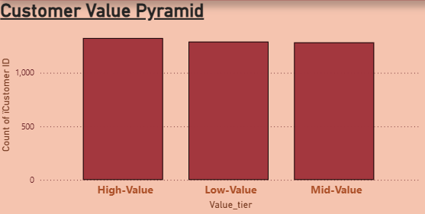
Decoding Customer Value: Moving From Volume to Margin-Driven Loyalty
Structural behavior analysis of 3,900 unique D2C profiles to secure retail margins.
THE PYTHON FEATURE CHALLENGE
Data Constraints: Raw matrix lacked pre-defined loyalty scores, churn labels, or historical timestamps. Imputed missing reviews with a dataset median of 3.75.extract_text()].
Engineered Indicators: * Dependency Score: Trailing promo voucher use rate per account.
CLV Proxy: Current item spend*(Previous Purchases + 1).
The Core Analytical Challenge (Model Test):
Model A (Frequency-Driven): Labeled 2,014 users as Loyal based strictly on >= 25$ purchases history.
Flaw: Over-indexes on artificial transaction volume by failing to filter out margin-diluting discount seekers.
Model B (Margin-Driven — SELECTED): Isolated 1,109 users who hold above-median CLV with 0% discount reliance.
Advantage: Pinpoints authentic full-retail brand pull.
High-Value Tier (Top Segment): * 1,325 Customers | $101,013 Gross Sales
Risk: 43.32% Promotional Reliance.
Mid-Value Tier (Middle Segment): * 1,284 Customers | $70,010 Gross Sales
Risk: 44.00% Promotional Reliance.
Low-Value Tier (Bottom Segment): * 1,291 Customers | $62,058 Gross Sales
Risk: 41.67% Promotional Reliance.

Slide 3
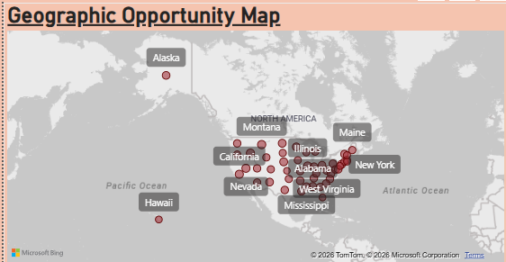
Diagnostic Insights: Pinpointing Revenue Leaks & Region Risks
Cross-tabulated behavioral data reveals structural flaws in the premium subscriber layer.
THE PREMIUM SUBSCRIBER DISCOUNT TRAP
The Cohort Inversion: The database tracks exactly 1,053 premium subscribers.
The Margin Leak: 100% of these active subscribers used a discount voucher code at checkout, compared to only 21.92% of non-subscribed buyers.
Zero Value Escalation: Premium subscribers do not buy higher basket averages. Their average order value sits at $59.49, virtually identical to non-subscribers ($59.87).
The Diagnostic Verdict: The subscription layer currently acts as an automatic margin-dilution loop for your most predictable, recurring customer base instead of driving incremental value.
Organic Pull Hub (Target for Expansion):
Montana: Yields the brand's maximum regional top-line revenue ($5,784).
Efficiency: Holds the country's lowest promotional reliance rate (37.50%), proving authentic organic brand equity.
The Promotion Trap (Target for Correction):
Nevada: Yields high top-line volume ($5,514).
Risk: Suffers from the nation's highest promotional dependency rate (47.13%). Nearly half of all regional transactions require margin-diluting vouchers to clear.

Slide 4
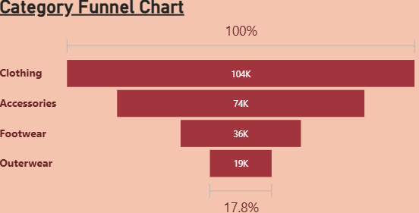
The Retention Playbook: Strategic Actions & Ideal Profile
Restructuring promotional structures and asset allocation using data-backed parameters..
THE PROMOTIONAL SUNSET PLAN
THE LOOK-ALIKE TARGET PROFILE (ICP)
Target Segment: High-Value Active Subscribers (1,053 profiles).extract_text()].
Trigger Behavior: Checkout transactions containing recurring promo code vouchers.extract_text()].
Rollout Timeline: 90-day phased structural sunset.extract_text()].
Days 1–30: Remove all automatic flat percentage discounts at digital checkout.
Days 31–90: Transition cohort to margin-neutral experiential perks (Free Priority Shipping, Early Access to Seasonal Drops, and Exclusive Member Size Options).
The Strategic Trade-Off (Required Rule):
What We Gain: Immediate claw-back of full retail gross margins across our most predictable recurring cohort.
What We Risk: Short-term volume contraction risk of ~5-8% in checkout frequency from opportunistic hunters during the initial 30 days.extract_text()].
Success Metric to Track: Subscriber Cohort Gross Margin Contribution (AOV Before vs. After Sunset).extract_text()].
Strategic Purpose: Redirect programmatic acquisition ad-spend away from high-discount regions (Nevada) toward organic demand sectors (Montana).extract_text()].
Data-Backed Targeting Matrix (SQL ICP Output):
Primary Cohort: Male/Female profiles aligning with top full-price retail buyers.
Purchasing Cadence: High-habituation clusters displaying a Weekly or Fortnightly buying frequency.
Inventory Entry Point: Route top-of-funnel marketing dollars to Clothing ($104,264 Sales) during Winter/Spring to lock in low-tenure new users.extract_text()].
Retention Mechanism: Cross-sell Accessories ($74,200 Sales), which naturally holds the highest customer historical tenure (25.73 average previous purchases).extract_text()].

Slide 5
Thank you

